Slide 1
Project No. : 7 Team Members : 1- Abraam Eissa Reda 2- Eslam Mohamed Eid Mohamed 3- Ahmed Salah Ahmed Abdel Aziz 4- Sama Hamdy Mohamed 5- Abdullah Mohamed Abd El Kader 6- Ali Mohamed Ali Hussain 7- Marwa Hamada Mansour 8- Walid Roshdy Sultan

Slide 2
Agenda
Introduction
Project Objective
Project Motivation
Implementation Scenario
Block diagram

Slide 3
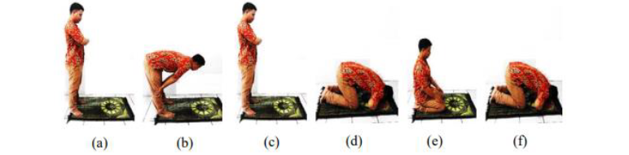
Introduction
Prayer is an essential pillar of the Islamic faith.
Mandatory religious rituals are performed five times a day.
These rituals represent a great challenge for elderly people whose vigilance and cognitive abilities decline with age.
When praying, the worshiper must perform a sequence, and elderly
People often have difficulty remembering which
cycle is being performed. However, incomplete
sequencing is unacceptable.

Slide 4
Project Objective
Accuracy: Examine the type of sensors used in the carpet. Sensors should be
sensitive and accurate to determine prayer positions precisely.
Reliability: Refers to the ability of a system, to consistently perform its
intended function or deliver its intended output without failure,
errors, or breakdowns, over a specified period of time and under
specific conditions.
Usability: Making easy to complete the prayer for people, especially the
elderly, who suffer from forgetfulness (forgetting the number of
rak’ahs, tashahhud, or prostration)

Slide 5
Project Objective
Flexibility: Smart prayer carpet with flexibility might imply that it can
be folded, rolled, or adjusted in different ways to
accommodate various prayer postures or to fit in different spaces.
This feature ensures that the carpet can be easily stored or
transported.

Slide 6
Project Motivation
Problems :
Teach the newcomers to Islam religion to pray .
Let him know the number of Rak’ahs that he made right .
Ensuring that he did not forget none of altashahud

Slide 7
Project Motivation
Inspiration :
We will use RGB LEDs instead of LCD displays that the praying person does not get distracted.
We will use a Battery that will be easy to move around instead of a Direct Source.

Slide 8
Implementation Scenario
We make sure that the power is on and connected to the smart carpet Then we start praying.
The RGB LED we have an equal number of (Rak’ahs) is four ,and one for Witness.
When the push button is active and the person chooses the pray all LEDs will be activated and begin red.
Use an ultrasonic sensor to measure the distance when the person kneels (Rak’ahs).
We use a pressure sensor(FSR) two for the left and right hand, and another on the forehead, when he bows down the pressure sensor is activated.
We use delay (make both two sujuds separated ) before he bows down again one of the 5 RGB LEDs converts from red into green, and he will repeat in the second (Rak’ahs) .

Slide 9
Implementation Scenario
The same he did in the first but the difference is that there is witnessing (altashahud) and we put an RGB LED that will be activated and turned it into yellow when he has done of It and if he made mistakes the RGB LED is still the same color(red).
As we know two witnessing (altashahud (Dhuhr, Asr, Maghrib, and Isha), so in the first RGB LED will convert into yellow, and in the second witnessing it will turn into green, and if the first is wrong the RGB is still red.
After completing the prayer, if he finds any LED in a color other than green, he must perform the prostration of forgetfulness.

Slide 10
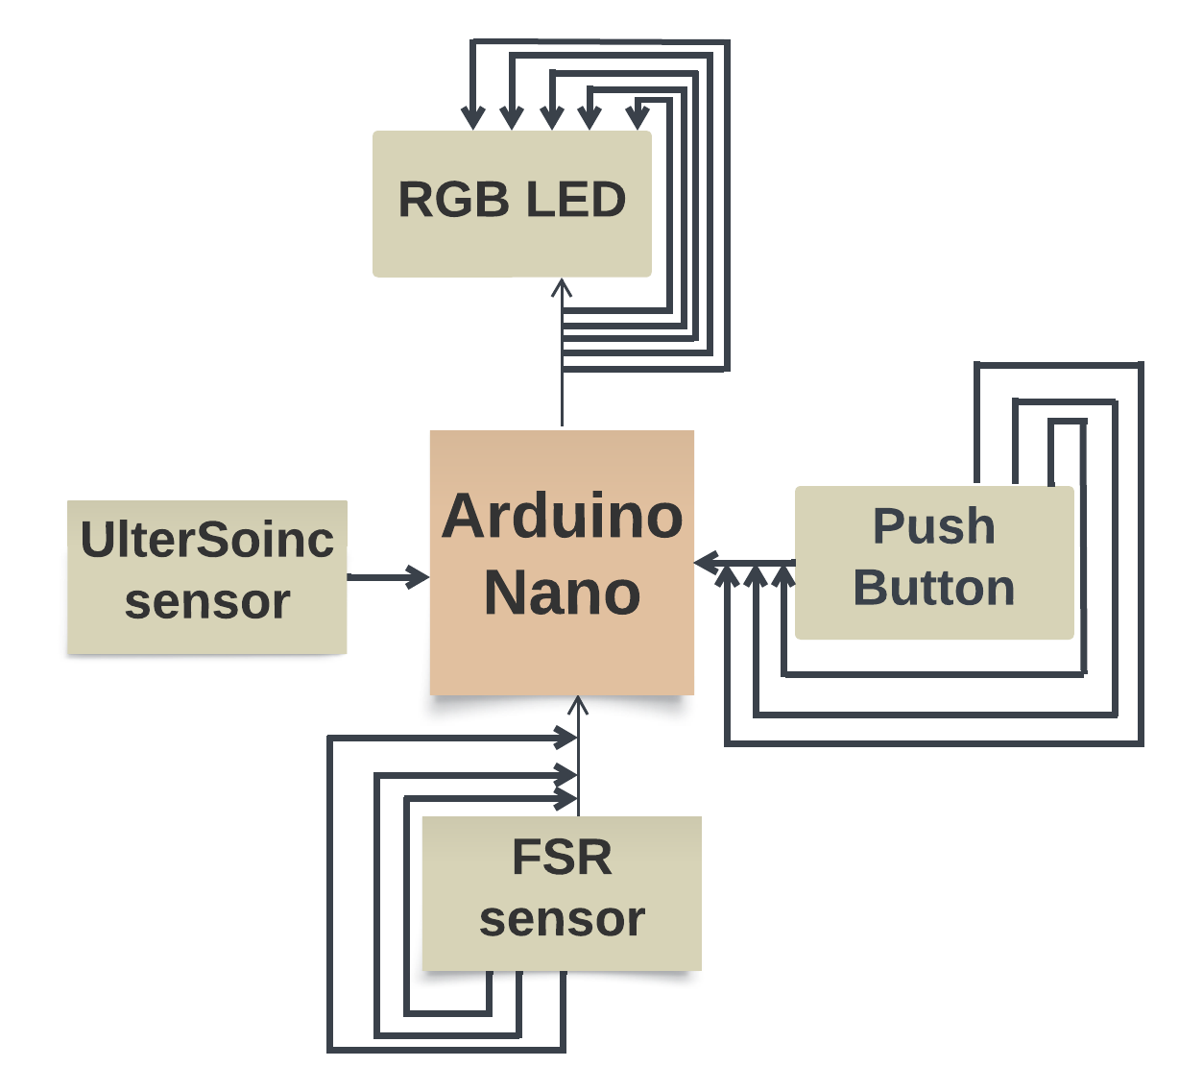
Block diagram

